Slide 1
Ready Set REGIS!
Kylie Becker SME 21 November 2018
@MedResearchNSW

Slide 2
Background
2012 The NSW Government undertook a strategic review of health and medical research in NSW.
Among the recommendations was the need to improve the information system to streamline ethics approval and site assessment processes.
2016 The contract end approached for the current system used in NSW (AU-RED/Online Forms)
NSW Health was obliged to undertake a competitive procurement process.
2017 Solution developer, F1 Solutions Pty Limited, was announced at the successful tender.
2018 REGIS was soft launched into most NSW Health LHD’s and ACT Health
Notes:
A brief background……….

Slide 3
Consistency
Transparency
Efficiency
Timeliness
How will it help?
Notes:
REGIS is being designed to improve:
Consistency - No matter where you log in to REGIS, the application and ongoing research governance requirements and processes will be similar across all NSW and ACT Health PHOs
All common forms are accessed through REGIS.
There is only one type of form for all (HREA/SSA/Progress Reports/Amdendments).
Transparency –The HREA, SSA and on-going project monitoring processes will be clearly communicated.
REGIS creates visibility. You are able to track your application in real-time through status – and status are the same for all sites/HRECs.
Visibility of projects can be shared with other members of the research team, sponsors and others.
Efficiency - The processes on which REGIS has been created are designed to enable approval/authorisation of research projects.
Show you shortly some slides showing this.
No need to print and send a hard copy or 15 to the research office.
When you submit the applications they are received by the office.
Timeliness - The system will send regular notifications and reminders from REGIS during pre-approval/authorisation and ongoing project monitoring stages.

Slide 4
Research Applicants
Who are the users?
Research Offices
HRECs
Ministry - OHMR
Heads of Dept (SSA)
Notes:
REGIS is the single portal for all stakeholder groups:
Research applicant (also Sponsors, CROs), the CPI will take responsibility for establishing their research project in REGIS. The CPI will register themselves and their project, completing the ethics application. At project registration, the CPI will nominate Principal Investigators (PIs) in the system for each site (if the project is spread across multiple sites) to later trigger the SSA process for research to be conducted in each location.
Researchers will continue to use REGIS for their ongoing research governance activities to meet reporting and other notification obligations for the duration of the research project.
Research Office staff Depending on their role, research office staff will process ethics (HREA) and/or site assessment (SSA) applications within REGIS, ensuring that each application meets the relevant criteria and will facilitate approval/authorisation processes.
Human Research Ethics Committee (HREC), the decision-making and review body and for approving research ethics applications, will see the committee agenda, all applicaitons under review for the meeting and the minutes post-meeting.
Local site executives include PHO Chief Executives and department heads. They will provide declarations of support and or/authorise (site assessment) research applications within REGIS. These are managed electronically within REGIS via system notifications and email reminders.
The Office for Health and Medical Research (OHMR) at NSW Health will provide metrics and oversee research being conducted from a NSW perspective. This information will be provided to the Deputy Secretary for Population and Public, the NSW Health Secretary, and where appropriate, the NSW Minister for Health and Mental Health.

Slide 5
Application process - ETH (perfect application!)
Application preparation
Application submitted to Research Office
Application review
Application decision
In-progress
Submitted
Eligible
Approved
Assigned to meeting
Under review
Notes:
In REGIS there is a very clear pathway for applications.
The perfect ethics application

Slide 6
Application process - ETH
Application preparation
Application submitted to Research Office
Application review
Application decision
In-progress
Submitted
Ineligible
Eligible
Approved
OR
OR
In-progress
Version n
Submitted
Version n
Approved with conditions
Assigned to meeting
OR
Not approved
Under review
Withdrawn
If no response in 60d
Withdrawn by applicant
Anytime up to decision
OR
Information requested
OR
Notes:
Not all applications are ‘perfect’ so in fact the flow of an ethics application could look more like this.

Slide 7
Application process - STE (perfect application!)
Application preparation
Application submitted to Research Office
Application review
Application decision
In-progress
Submitted
Eligible
Authorised
Pending submission
Completed pending HOD
Notes:
Similarly for the perfect site application there is a well designed flow of the application.
Something of interest at this point is that the research office can see an application from the time it is created “in progress”.
Previously the time an application was being completed or the time it was taking to get the department support can be better managed.
This isn’t to say that the applicants responsibility is removed. It is still expected that the applicants are speaking to the other parties connected to the application. While REGIS is a single system it doesn’t negate the need to communicate.

Slide 8
Application process - STE
Application preparation
Application submitted to Research Office
Application review
Application decision
In-progress
Submitted
Eligible
Authorised
Pending submission
OR
Submitted
Version n
Ethics approval received
Authorised with conditions
Completed pending HOD
Valid
OR
HOD not supported
Not authorised
Information provided
Version n
Ineligible
OR
In-progress
Version n
Withdrawn
If no response in 60d
Withdrawn by applicant
Anytime up to decision
Information requested
OR
OR
OR
OR

Slide 9
REGIS - Statuses, by stage
Ethics & Site Governance Applications
Notes:
REGIS is a status driven system – the system allocates the status based on the actions of the research applicant and research office.
These status are consistent across all applications in REGIS.
Blue – ethics and site governance.
Green – ethics only
Orange – site governance only

Slide 10
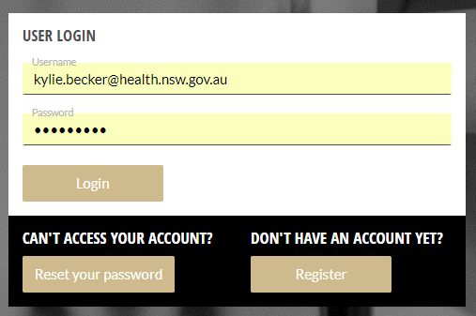
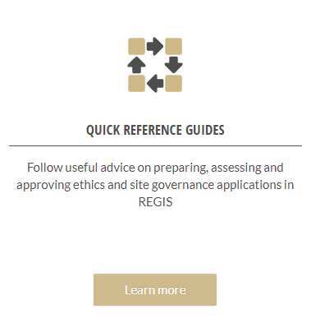
Preparing for REGIS
Create a REGIS login
https://regis.health.nsw.gov.au/
Read Quick Reference Guides
https://regis.health.nsw.gov.au/how-to/
Notes:
Anyone can create a REGIS account:
Who needs a REGIS account?
Anyone who will be creating project registrations.
Anyone who will be taking on the Role of Coordinating Principal Investigator, Principal Investigator, Associate Investigator.
Anyone who wants/needs to have view and or edit access to an project.
Read the quick reference guides:
QRGs are easy to follow 2-3 page documents that step you through a specific process.
REIGS is new and it is different - There are system implications to some responses - Knowing how to talk to REGIS will make your job easier.
Currently 8 Research Applicant QRG’s with more to be released as required.

Slide 11
Important Dates
1 December 2018 – Many NSW Health LHD’s/HRECS will start accepting all new applications in REGIS
Contact the research office before you commence Registration to confirm if they are accepting through REGIS.
April 2019 – Online forms will not longer accept applications for NSW Health and ACT Health.

Slide 12
Before you apply in REGIS
Do the following people have a REGIS account?
Coordinating Principal Investigator
Principal Investigator/s
Associate Investigators
Admin Contacts
Electronic Documents
Keep filenames as short as possible
Filenames should not contain version numbers or dates (these would still appear in the document)
This will assist REGIS in successfully managing versioning in the system
Shorten the amount of time it takes a research office to create an approval notification
Reduce error in approval notifications

Slide 13
Registering your Project
All new applications start with Project Registration
Captures project level information that is shared between the Ethics and Governance Applications (reducing duplication)
Anyone with a REGIS account can complete project registration

Slide 14
Demo – Project Registration

Slide 15
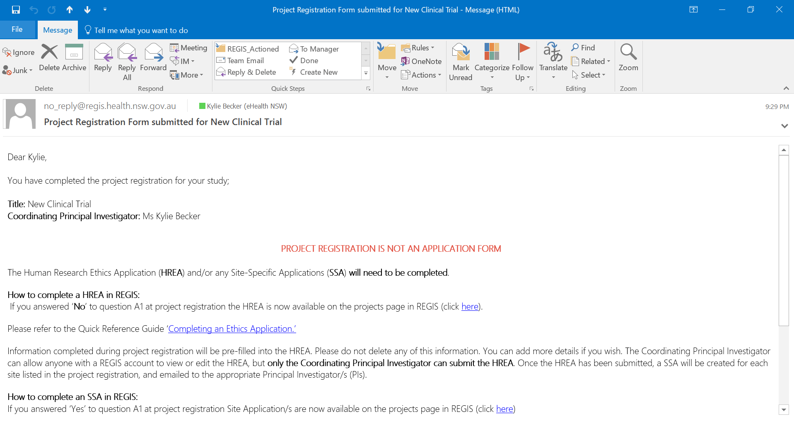
Notes:
An example of a system generated email.

Slide 16
Demo - HREA

Slide 17
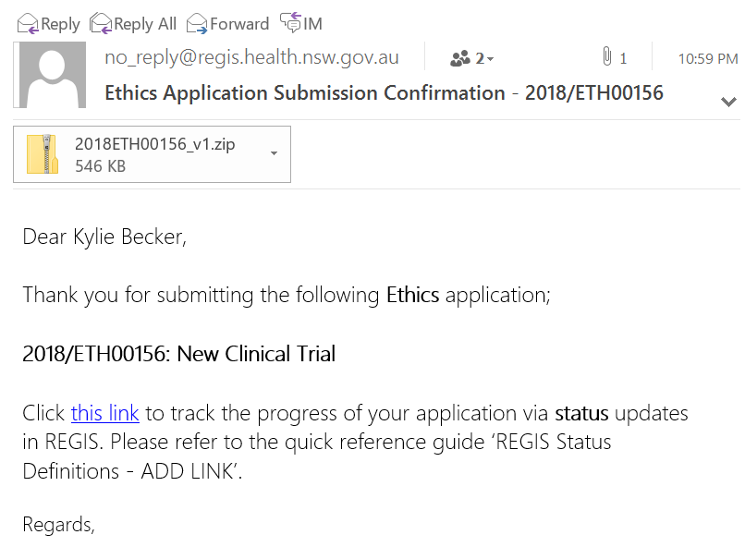
Notes:
On submission of the HREA the CPI and admin contact will receive a submission confirmation with a copy of the documents submitted.
If the application was a multi jurisdiction study these documents can be used to compete the application process in the other systems.

Slide 18
Notes:
Principal Investigators are also send a system generated email letting them know the Site Application is now available in REGIS.

Slide 19
Demo – Site Application

Slide 20
Notes:
The system send an automated submission confirmation

Slide 21
Notes:
Principal Investigator is notified when all Head’s of Department have signed off.

Slide 22
NMA multi-centre studies
Project Registration:
A1 Has an application for ethics review of this project previously been submitted to a recognised HREC?
A5 Was/Is application being reviewed under NMA scheme?
https://www.medicalresearch.nsw.gov.au/national-mutual-acceptance/

